Slide 1


High Performance Computing
Dr. Amit Barve,
Associate Professor and Head of the Department,
CSE department, PIET, PU

Slide 2
Communication Costs in Parallel Machines
Along with idling and contention, communication is a major overhead in parallel programs.
The cost of communication is dependent on a variety of features including the programming model semantics, the network topology, data handling and routing, and associated software protocols.

Slide 3
Message Passing Costs in Parallel Computers
The total time to transfer a message over a network comprises of the following:
  Startup time (ts): Time spent at sending and receiving nodes (executing the routing algorithm, programming routers, etc.).
  Per-hop time (th): This time is a function of number of hops and includes factors such as switch latencies, network delays, etc.
  Per-word transfer time (tw): This time includes all overheads that are determined by the length of the message. This includes bandwidth of links, error checking and correction, etc.

Slide 4
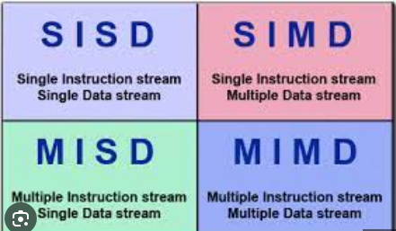
Flynn’s Taxonomy

Slide 5
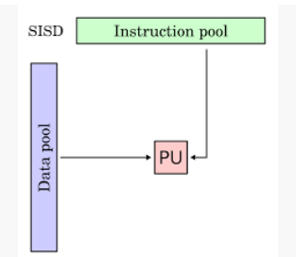
SISD

Slide 6
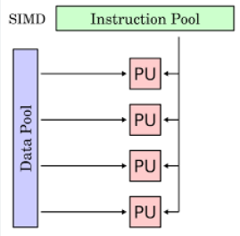
SIMD

Slide 7
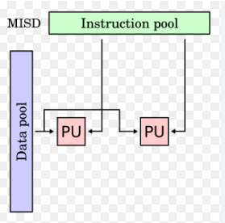
MISD

Slide 8
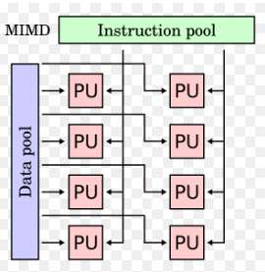
MIMD

Slide 9
Data Models
Program Models
Shared Data
SPMD
Shared Queue
Master/Worker
Distributed Array
Loop Parallelism
These are not necessarily mutually exclusive.
Fork/Join

Slide 10
Program Models
SPMD (Single Program, Multiple Data)
  All PE’s (Processor Elements) execute the same program in parallel, but has its own data
  Each PE uses a unique ID to access its portion of data
  Different PE can follow different paths through the same code
  This is essentially the CUDA Grid model
  SIMD is a special case - WARP
Master/Worker
Loop Parallelism
Fork/Join

Slide 11
Program Models
SPMD (Single Program, Multiple Data)
Master/Worker
  A Master thread sets up a pool of worker threads and a bag of tasks
  Workers execute concurrently, removing tasks until done
Loop Parallelism
  Loop iterations execute in parallel
  FORTRAN do-all (truly parallel), do-across (with dependence)
Fork/Join
  Most general, generic way of creation of threads

Slide 12
SPMD and MPMD
When we run multiple processes with message-passing, there are further categorizations regarding how many different programs are cooperating in parallel execution
We distinguish between two models:
  Single Program Multiple Data (SPMD) model
  Multiple Programs Multiple Data (MPMD) model

Slide 13
SPMD
In the SPMD model, there is only one program and each process uses the same executable working on different sets of data
a.out
Node 1
Node 2
Node 3

Slide 14
MPMD
The MPMD model uses different programs for different processes, but the processes collaborate to solve the same problem
MPMD has two styles, the master/worker and the coupled analysis
a.out
b.out
a.out
b.out
c.out
a.out= Structural Analysis,
b.out = fluid analysis and
c.out = thermal analysis
Example
Node 1
Node 2
Node 3
Node 1
Node 2
Node 3
1. MPMD: Master/Slave
2. MPMD: Coupled Analysis

Slide 15
SIMT = Single-Instruction Multiple Threads
Coined by Nvidia
Combines SIMD execution within a Block (on an SM) with SPMD execution across Blocks (distributed across SMs)

Slide 16
Data Flow Model
Conventional programming models are control driven
  Instruction sequence is precisely specified
  Sequence specifies control
    which instruction the CPU will execute next
Execution rule:
  Execute an instruction when its predecessor has completed
  s1: r = a*b;
  s2: s = c*d;
  s3: y = r + s;
s2 executes
when s1 is complete
s3 executes
when s2 is complete

Slide 17
Data Flow
Consider the calculation
  y = a*b + c*d
Represent it by
a graph
  Nodes represent
  computations
  Data flows along
  arcs
Execution rule:
  Execute an instruction
  when its data is available
  Data driven rule
a
b
d
c
x
x
+
y

Slide 18
Data Flow
Dataflow firing rule
  An instruction fires (executes)
  when its data is available
Exposes all possible
parallelism
  Either multiplication can
  fire as soon as data arrives
  Addition must wait
Data dependence analysis!
  Instruction issue units:
    Fire (issue) each instruction
    when its operands (registers) have been written
a
b
d
c
x
x
+
y

Slide 19
Data Flow - Realisations
Several Experimental Machines built
  Manchester Gurd & Watson
  Tagged Token Arvind, MIT
  Sigma ETL, Tsukuba
  EMC-4 ETL, Tsukuba
  Monsoon Arvind, MIT
  EMX ETL, Tsukuba
  RAPID Osaka/Sharp/Mitsubishi
  (Asynchronous!)
  Naiad Tasmania
  and some others

Slide 20
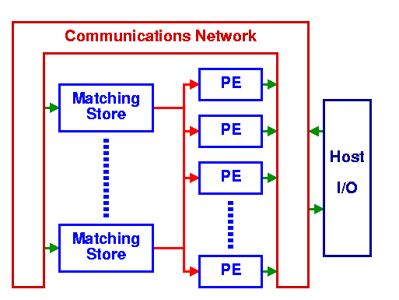
Data Flow - Realisations
Manchester

Slide 21

Data Flow - Program
Program word
  Matching Store Entry
Destination
Left or Right
Left, Right
Operands
Destination
Address
Operation
+, -, *, /
etc
Presence
Flags
When both Presence Flags are Y,
this packet is despatched to a PE (any PE!)

Slide 22
Data Flow - Matching Store
Special purpose memory
  Limited processing capability
  Detects full slots
  Dispatches operation packets to any idle PE
Destination
Left or Right
Operation
+, -, *, /
etc
Left, Right
Operands
Destination
Address
Presence
Flags

Slide 23

Data Flow - Processing Elements
Receive operation packets
Generate result
Form result packet
Despatch to matching store

Slide 24
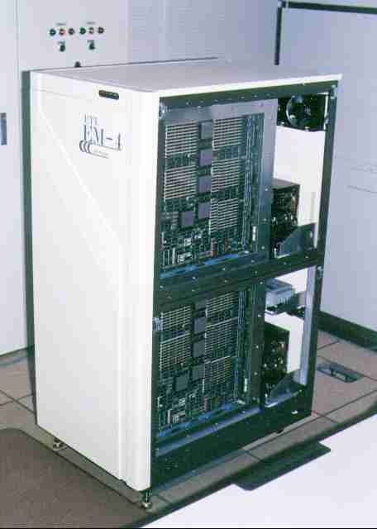
Data Flow - EM4
Architects
  Yamaguchi,
  Sakai, Kodama,
  Sato et al
  ElectroTechnical
  Laboratory,
  Tsukuba,
  Japan
PE (EM-Y)
  CMOS Gate Array
  80k gates / 1.0μ
  f = 20MHz
  ~1992

Slide 25

Data Flow - Monsoon
Architects
  Papadopoulos, Culler
  et al
  MIT, Cambridge
PE
  f = 10MHz
  ~1990
I-Structure
Processor

Slide 26
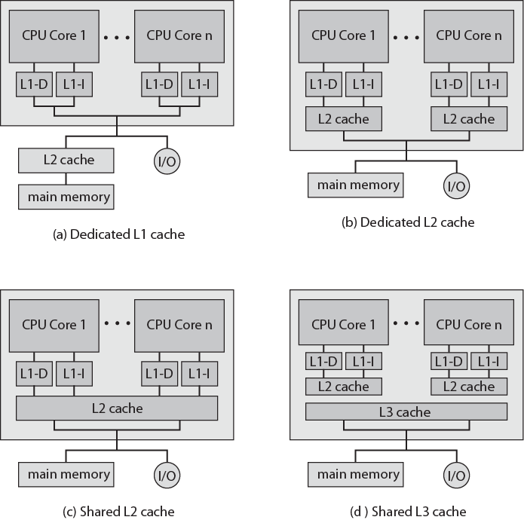
Multicore Organization Alternatives

Slide 27
Advantages of shared L2 Cache
Constructive interference reduces overall miss rate
Data shared by multiple cores not replicated at cache level
With proper frame replacement algorithms mean amount of shared cache dedicated to each core is dynamic Threads with less locality can have more cache
Easy inter-process communication through shared memory
Cache coherency confined to L1
Dedicated L2 cache gives each core more rapid access
  Good for threads with strong locality
Shared L3 cache may also improve performance

Slide 28
Individual Core Architecture
Intel Core Duo uses superscalar cores
Intel Core i7 uses simultaneous multi-threading (SMT)
  Scales up number of threads supported
    4 SMT cores, each supporting 4 threads appears as 16 core

Slide 29


www.paruluniversity.ac.in

